Slide 1
Repeating Actions (Loops)
By Sanjay and Arvind Seshan

Slide 2
Lesson Objectives
Learn how to repeat an action
Learn how to use Loop Blocks

Slide 3
Repeating an Action
Let’s say we want the robot to repeat an action over and over again.
Would you just copy the block multiple times?
Sure, that could work!
What if I want to repeat that block forever?
Now what?

Slide 4
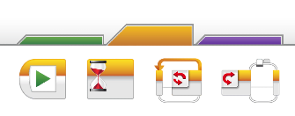
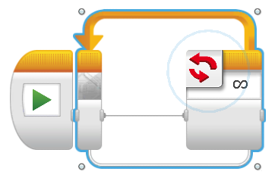
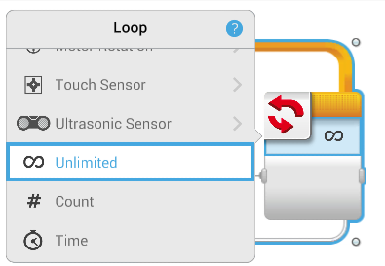
Loops
Loops make repeating a task multiple times easy
The added benefit is that a loop can end whenever you want (a specific number of times, run forever, a specific condition, etc)

Slide 5
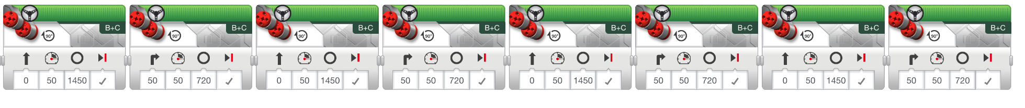
LOOP CHALLENGE
Challenge: Write a program to go around a box once.
The simple way is to code it like this:
Use a loop to improve the code

Slide 6
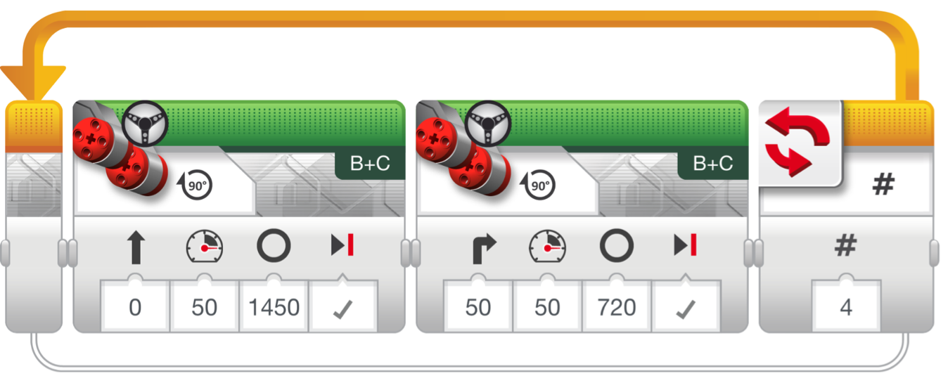
Loop Challenge Solution

Slide 7
Credits
This tutorial was created by Sanjay Seshan and Arvind Seshan
More lessons are available at www.ev3lessons.com
This work is licensed under a Creative Commons Attribution-NonCommercial-ShareAlike 4.0 International License.

