Slide 1
Switches
By Sanjay and Arvind Seshan

Slide 2
Lesson Objectives
Learn how to make your robot decide what to do out of different choices
Learn how to use a Switch Block

Slide 3
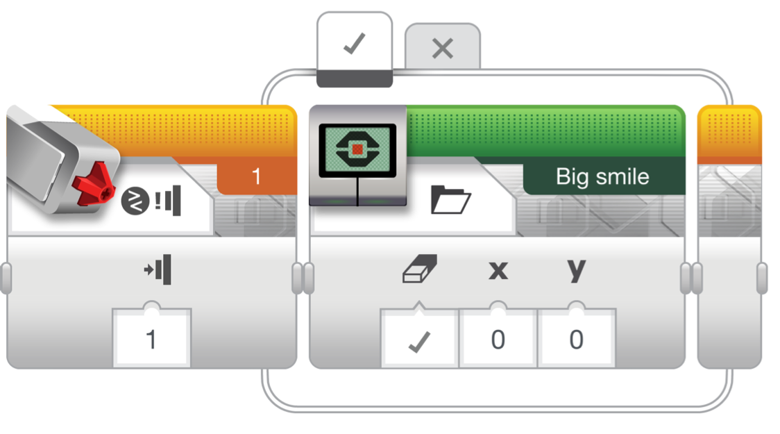
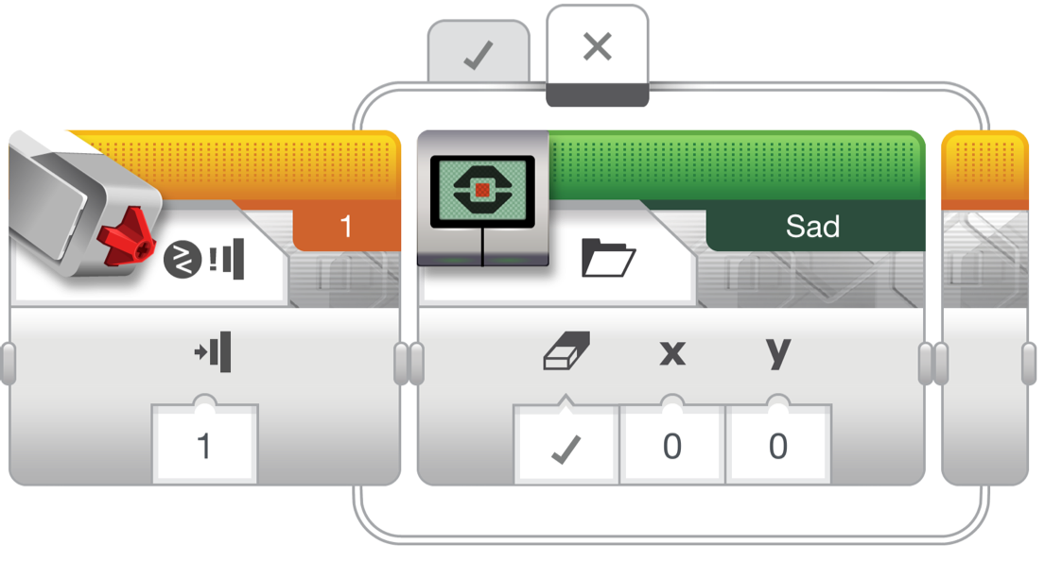
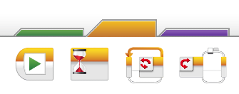
Switch Blocks
Run this code if the answer is no
Run this code if the answer is yes
Asking the robot a question and doing something different based on the answer
Example: Does the robot see a line? Or not?
Basically a YES/NO QUESTION
Switch blocks are found in the orange/flow tab
The question being asked: is the touch sensor pressed
Animated Slide

Slide 4

Switch Block Challenge 1
Challenge: Write a program that changes the display based on if the touch sensor is pressed or not pressed.
If pressed, your EV3 is happy! Display a smiley face. If not pressed, the EV3 is sad! Display a sad face.
Hint: You will need to use the display block, loops and switch blocks!

Slide 5
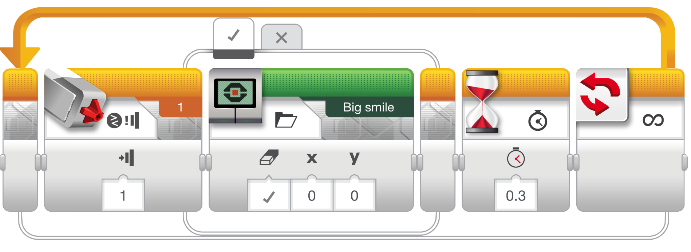
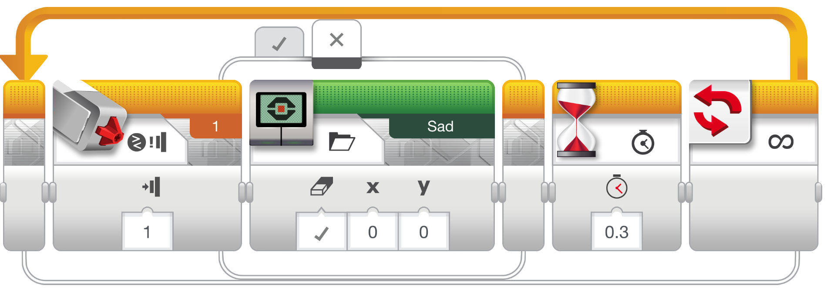
Challenge 1 Solution
Touch Sensor
Pressed
Display Block
Wait Block
Loop
Animated Slide

Slide 6
Switch Block Challenge 2
Can you write a program that display big eyeballs if you touch it once and a sad face if you touch it a second time and toggles back and forth.

Slide 7
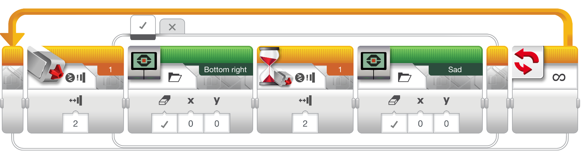
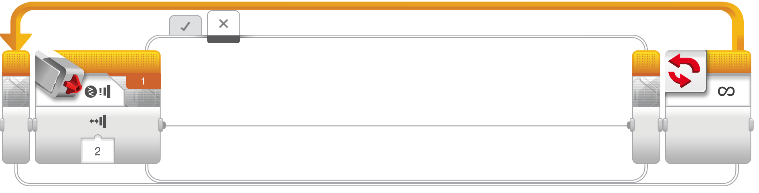
Challenge 2 solution
Animated Slide

Slide 8
Credits
This tutorial was created by Sanjay Seshan and Arvind Seshan
More lessons are available at www.ev3lessons.com
This work is licensed under a Creative Commons Attribution-NonCommercial-ShareAlike 4.0 International License.

